Slide 1
Do Now
Decide if these statements are TRUE or FALSE.
A solid piece of wood can be compressed.
Liquids have a fixed volume.
A solid will hold its shape if left alone on a table.
A gas can expand to fill the whole room.
The particles in a gas are moving very slowly.
The particles in a solid can move around each other.
The particles in a liquid vibrate
All particles are always moving.
FALSE
TRUE
TRUE
TRUE
FALSE
FALSE
FALSE
TRUE

Slide 2
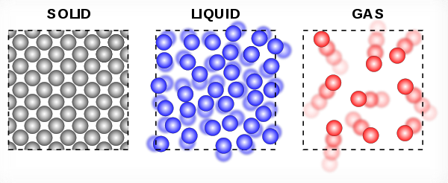
Daily Review
CFU 1
Can you see the particles that matter is made of?
The kinetic theory is made up of four main ideas:
All matter is made of a huge number of tiny particles which are far too small to see.
There is nothing between the particles.
The particles are always moving.
As temperature increases, the particles move more (their kinetic energy increases).
This theory allows us to explain the volume, shape and compressibility of the different states of matter.
CFU 2
What is in between the particles?
CFU 3
True or False: gas particles are constantly moving, but liquid and solid particles stay still.

Slide 3
Daily Review
CFU 1
How are these particles arranged?
Solids:
held closely together in a regular (consistent) pattern
only vibrate – they do not move around other particles
Liquids:
packed closely together in a random way
can move around each other and other particles
Gases:
spaced far apart in a random way
constantly moving at high speeds
CFU 2
How do these particles move?
CFU 3
Which of these features explains the property?
Example:
Can a solid be compressed? Why or why not?
A solid cannot be compressed because the particles have no space for them to be pushed together.
Vocabulary
compressed (verb) made smaller by applying pressure

Slide 4
Daily Review
CFU 1
How are these particles arranged?
Solids:
held closely together in a regular (consistent) pattern
only vibrate – they do not move around other particles
Liquids:
packed closely together in a random way
can move around each other and other particles
Gases:
spaced far apart in a random way
constantly moving at high speeds
CFU 2
How do these particles move?
CFU 3
Which of these features explains the property?
Explain why a solid can be forced through a liquid.
Vocabulary
compressed (verb) made smaller by applying pressure

Slide 5
Daily Review
CFU 1
How are these particles arranged?
Solids:
held closely together in a regular (consistent) pattern
only vibrate – they do not move around other particles
Liquids:
packed closely together in a random way
can move around each other and other particles
Gases:
spaced far apart in a random way
constantly moving at high speeds
CFU 2
How do these particles move?
CFU 3
Which of these features explains the property?
Do gases have a fixed (unchangeable) volume? Why or why not?
Vocabulary
compressed (verb) made smaller by applying pressure

Slide 6
Diffusion Year 8 Science

Slide 7
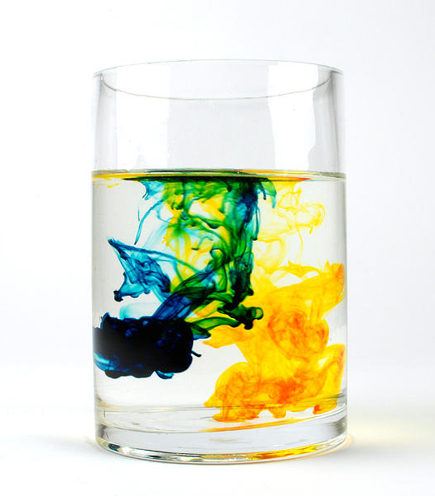
Learning Objective
CFU
What are we going to learn?
Define and explain diffusion using the kinetic theory.
Represent diffusion visually.
Activate Prior Knowledge
Kevin drops some yellow dye and some blue dye into a glass of water.
What do you expect will happen next?

Slide 8
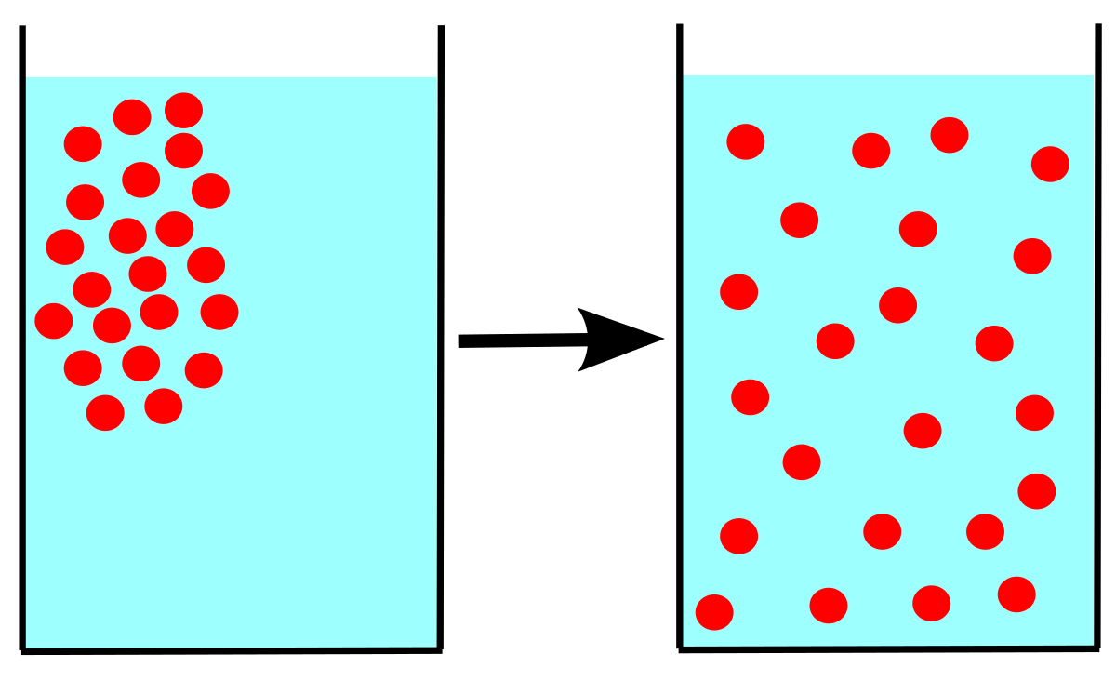
Concept Development
CFU 1
What is diffusion?
Diffusion: when particles spread out from an area with lots of particles to an area with few or no particles.
CFU 2
Where do particles move from? Where do they move to?
Vocabulary
diffusion (noun) the movement of particles from an area of high concentration to an area of low concentration

Slide 9
Concept Development
CFU 1
What is required for diffusion to happen?
Diffusion only works in states of matter that allow particles to move around. If particles can’t move, they can’t spread out, and diffusion can’t happen.
Remember, all matter is always moving, but not all states allow particles to move around each other.
CFU 2
Which state/s of matter (solid / liquid / gas) allow diffusion, and why?
CFU 3
Which state/s of matter (solid / liquid / gas) do not allow diffusion, and why?
Vocabulary
diffusion (noun) the movement of particles from an area of high concentration to an area of low concentration

Slide 10
Skill Development / Guided Practice
CFU 1
What is the first step in predicting diffusion?
Will it diffuse?
Predicting and explaining diffusion is a simple process:
Identify the state/s of matter (solid / liquid / gas)
Describe the movement of the particles in the substances
Use your description to explain why diffusion will / won’t happen
CFU 2
What do you need to describe?
CFU 3
What do you use when explaining why diffusion does or doesn’t happen?
Vocabulary
diffusion (noun) the movement of particles from an area of high concentration to an area of low concentration

Slide 11
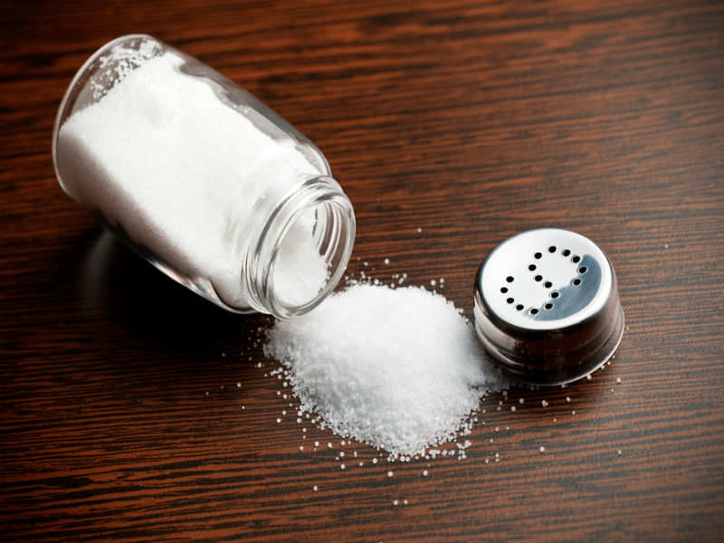
Skill Development / Guided Practice
CFU 1
What state/s of matter are involved?
Will it diffuse?
Identify the state/s of matter (solid / liquid / gas)
Describe the movement of the particles
Use your description to explain why diffusion will / won’t happen
Salt is spilt on a table. Will it diffuse?
The table and the salt are both solid.
Solid particles are fixed in place and can only vibrate.
Because of this, the particles cannot diffuse.
CFU 2
How do the particles move?
CFU 3
Will this motion allow diffusion to happen? Why / why not?
Vocabulary
diffusion (noun) the movement of particles from an area of high concentration to an area of low concentration

Slide 12

Skill Development / Guided Practice
CFU 1
What state/s of matter are involved?
Will it diffuse?
Identify the state/s of matter (solid / liquid / gas)
Describe the movement of the particles
Use your description to explain why diffusion will / won’t happen
Milk is added to tea. Will it diffuse?
Milk and tea are both liquids. In liquids, particles can move around each other. This allows the milk to gradually spread out (diffuse) through the tea.
CFU 2
How do the particles move?
CFU 3
Will this motion allow diffusion to happen? Why / why not?
CFU 3
Will diffusion happen quickly or slowly? Why?
Vocabulary
diffusion (noun) the movement of particles from an area of high concentration to an area of low concentration

Slide 13
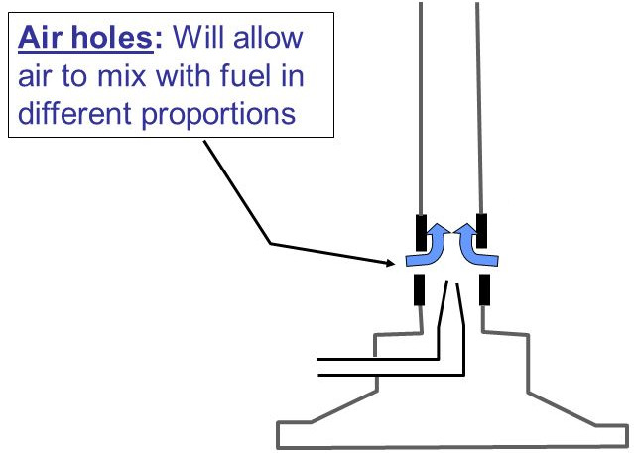
Skill Development / Guided Practice
CFU 1
What state/s of matter are involved?
Will it diffuse?
Identify the state/s of matter (solid / liquid / gas)
Describe the movement of the particles
Use your description to explain why diffusion will / won’t happen
In a Bunsen burner, air is added to propane gas. Will it diffuse?
CFU 2
How do the particles move?
CFU 3
Will this motion allow diffusion to happen? Why / why not?
CFU 3
Will diffusion happen quickly or slowly? Why?
Vocabulary
diffusion (noun) the movement of particles from an area of high concentration to an area of low concentration

Slide 14
Relevance
Diffusion is everywhere – perfume, tea, cooking, soft drinks, pollution, your body, and much more.
Diffusion is an important application of the kinetic theory.
Skill Closure
Reminder
Will it diffuse? Identify the state/s of matter (solid / liquid / gas) Describe the movement of the particles Use your description to explain why diffusion will / won’t happen
When particles diffuse, where do they come from and where do they go?

Slide 15
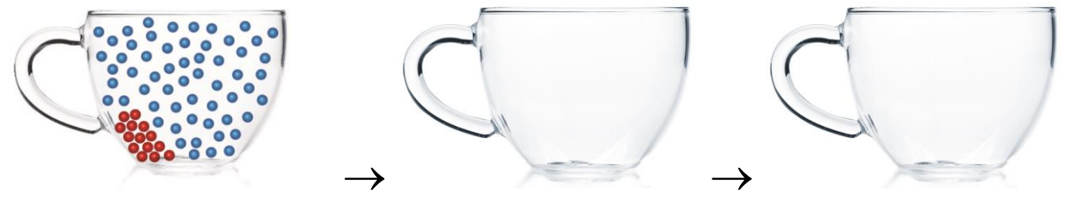
Independent Practice
The following diagram represents a teabag in a hot cup of water. In the other glasses, draw the particles to demonstrate what happens to the tea as it diffuses throughout the water.
Vocabulary
diffusion (noun) the movement of particles from an area of high concentration to an area of low concentration

